Slide 1
Architectural Design
Client / Server Architecture
Data Flow (Pipe and Filter)
Layered Architecture
Call and Return Architecture
Data Centered Architecture

Slide 2
Peer to Peer
Each component acts as its own process and acts as both a client and a server to other peer components.
Any component can initiate a request to any other peer component.
Characteristics
Scale up well
Increased system capabilities
Highly tolerant of failures
Notes:
BitTorrent is an example

Slide 3
Publish Subscribe
Components interact by broadcasting and reacting to events
Component expresses interest in an event by subscribing to it
When another component announces (publishes) that event has taken place, subscribing components are notified
Implicit invocation is a common form of publish-subscribe architecture
Registering: subscribing component associates one of its procedures with each event of interest (called the procedure)
Characteristics
Strong support for evolution and customization
Easy to reuse components in other event-driven systems
Need shared repository for components to share persistent data
Notes:
Difficult to test

Slide 4
Component Design
Notes:
=

Slide 5
Component
“... a modular, deployable and replacable part of the system that encapsulates implementation and exposes a set of interfaces”
Has an internal and external view
Object-oriented view

Slide 6
OO Design
Object oriented methodologies are the most popular and sophisticated design methodologies
A design is object oriented if it decomposes a system into a collection of runtime components called objects that encapsulate data and functionality
The implementation of an object can be reused and extended via inheritance, to define the implementation of other objects
OO code can be polymorphic: written in generic code that works with objects of different but related types

Slide 7
OO Design: Inheritance vs Composition
A key design decision is determining how best to structure and relate complex objects
In an OO system, there are two main techniques for constructing large objects
Inheritance
composition
A new class can be created by extending and overriding the behavior of an existing class, or it can be created by combining simpler classes to form a composite class.

Slide 8
OO Design: Inheritance vs Composition
Each construction paradigm has advantages and disadvantages
Composition is better than inheritance at preserving the encapsulation of the reused code, because a composite object accesses the component only through its advertised interface
By contrast, using the inheritance approach, the subclass’s implementation is determined at design time and is static
The resulting objects are less flexible than objects instantiated from composite classes because the methods they inherit from their parent class cannot be changed at runtime
The greatest advantage of inheritance is the ability to change and specialize the behaviors of inherited methods, by selectively overriding inherited definitions

Slide 9
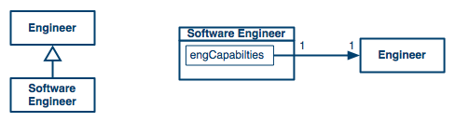
OO Design: Inheritance vs Composition

Slide 10
Representing OO Design using UML
The UML is a suite of design notations that is popular for describing OO solutions
The UML can be used to visualize, specify, or document a software design
UML especially useful for describing different design alternatives, and eventually for documenting design artifacts

Slide 11
Representing OO Design using UML
Use case diagrams
UML activity diagrams
Domain model
Component diagrams
Deployment diagrams
Class diagrams
Interaction diagrams
Sequence diagrams
Communication diagrams
Activity diagrams
State diagrams
Package diagrams

Slide 12
Representing OO Design using UML
How UML is used in the development process
Requirements
Architecture
Design
Domain models
UML sequence diagrams
UML communication diagrams
UML use case diagrams
Scenarios
UML object diagrams
UML component diagrams
UML class diagrams
UML activity diagrams
UML package diagrams
UML deployment diagrams
UML activity diagrams
UML state diagrams

Slide 13
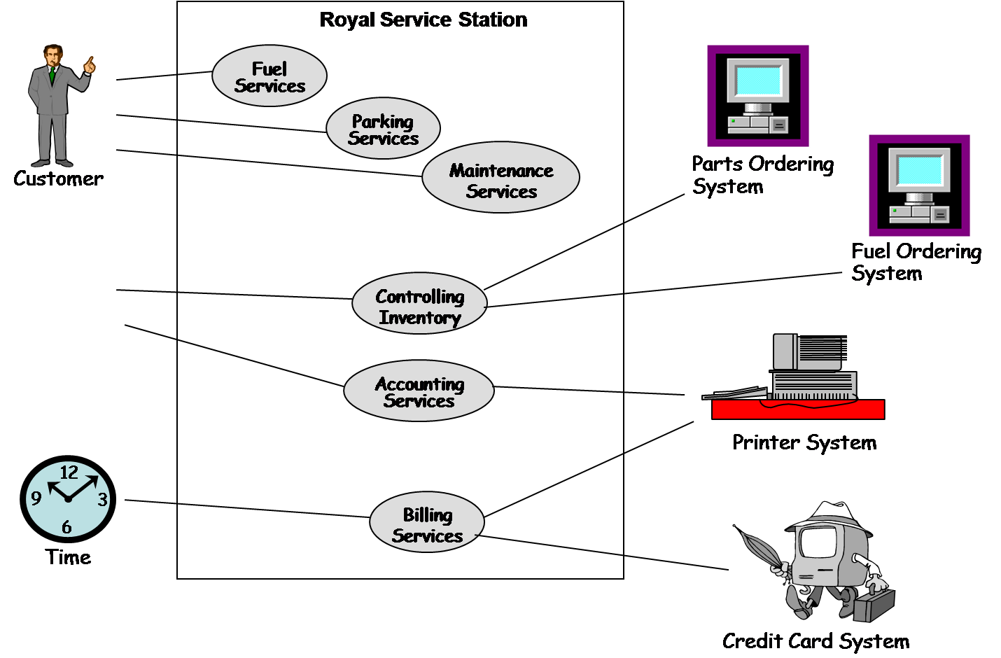
Representing OO Designs in the UML Usecase Diagram
Royal Service Station use case diagram

Slide 14
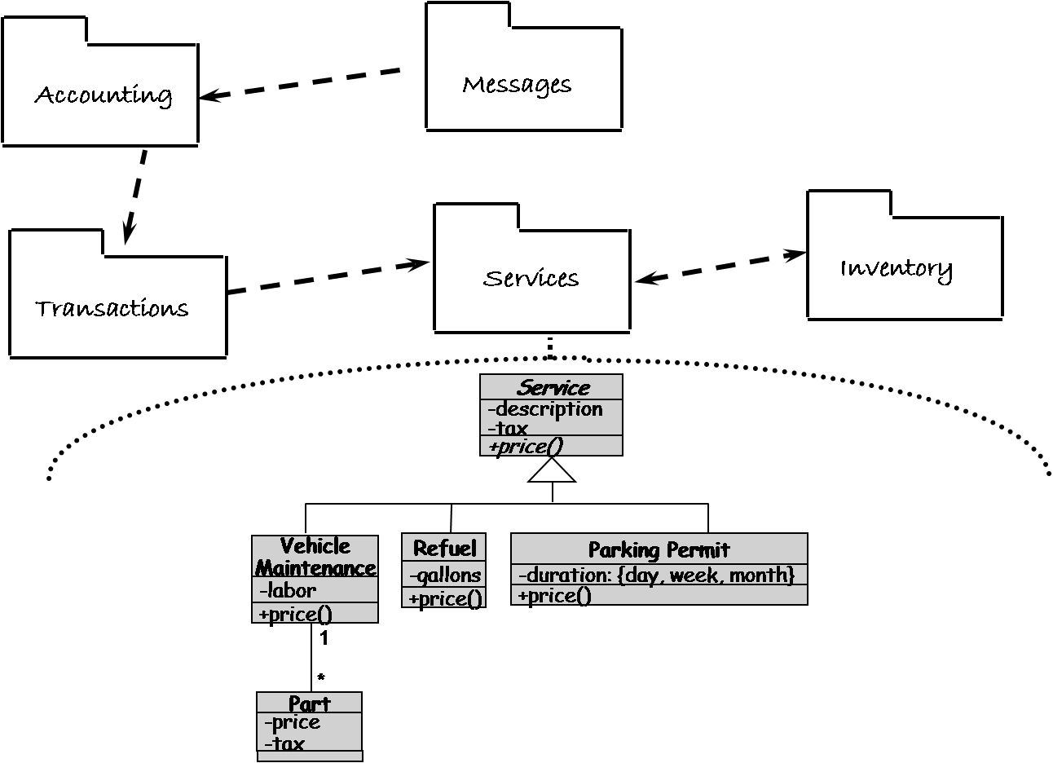
Representing OO Designs in the UML Other UML Diagrams: Package Diagram
UML package diagrams allow viewing a system as a small collection of packages each of which may be expanded to a larger set of classes

Slide 15
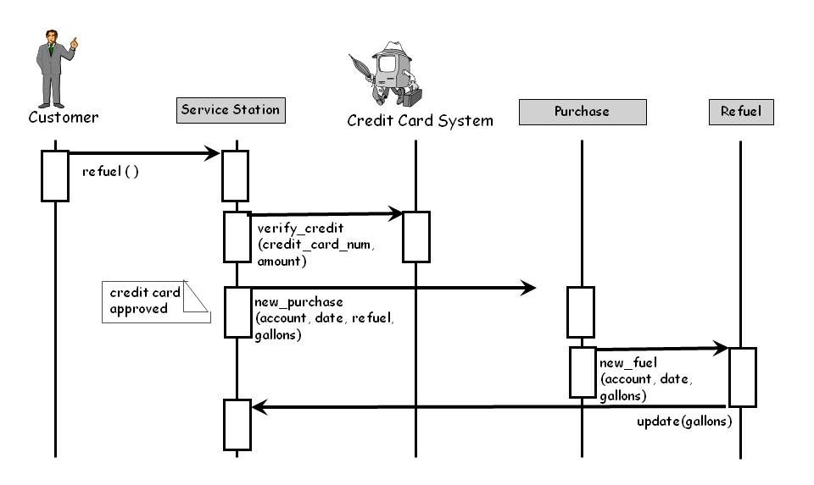
Representing OO Designs in the UML Other UML Diagrams: Sequence Diagram
Interaction diagrams describe how operations and behaviors are realized by the objects

Slide 16
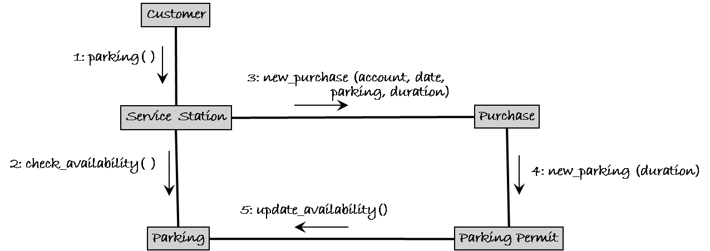
Representing OO Designs in the UML Other UML Diagrams: Communication/Collaboration Diagram
A communication diagram depicts a sequence of messages between objects but it is superimposed on an object and uses the links between object as implicit communication channels

Slide 17
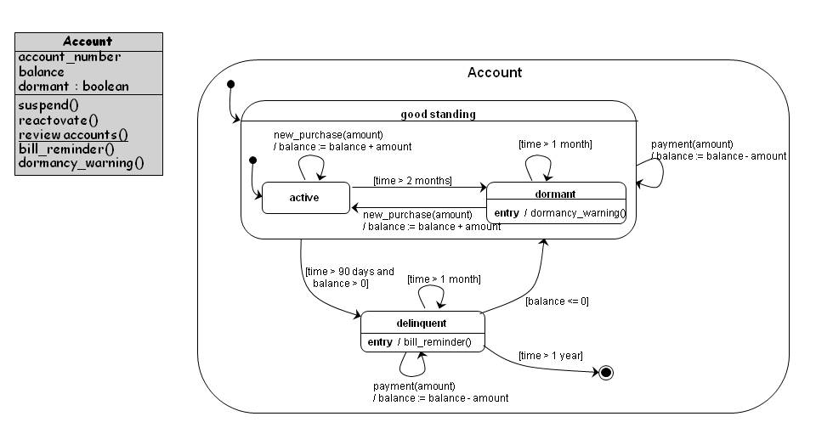
Representing OO Designs in the UML Other UML Diagrams: State Diagram
A state diagram shows the possible states an object can take, the events that trigger the transition between one state to the next, and the actions that result from each state change

Slide 18
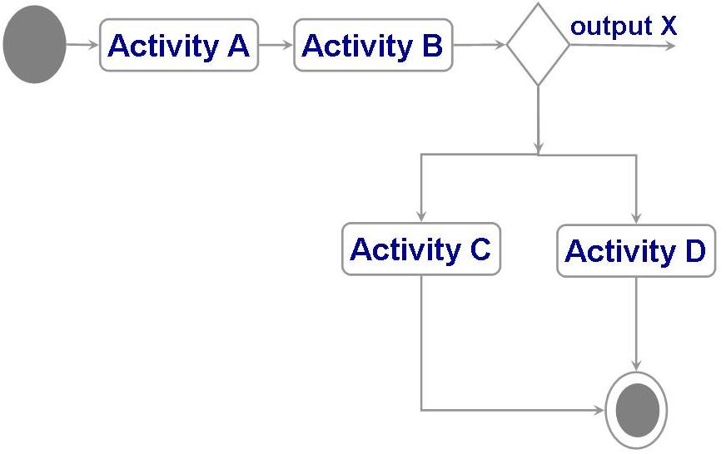
Representing OO Designs in the UML Other UML Diagrams: Activity Diagram
Activity diagrams are used to model the flow of procedures or activities in a class
A decision node is used to represent a choice of which activity to invoke

Slide 19
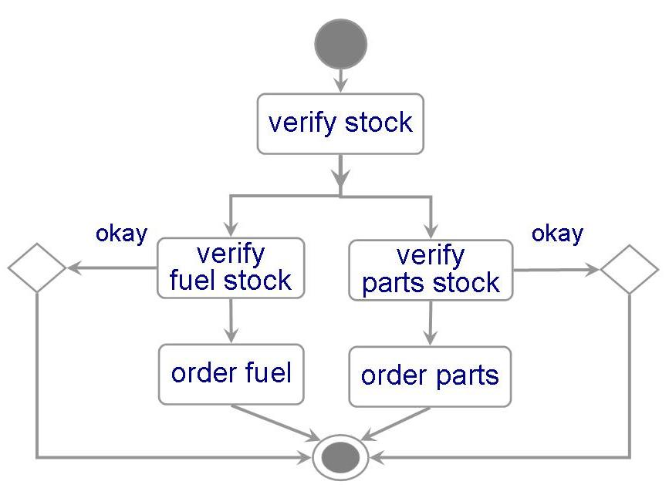
Representing OO Designs in the UML Other UML Diagrams: Activity Diagram
Activity diagrams are used to model the flow of procedures or activities in a class
An activity diagram for the inventory class
It may have two decisions
to verify that there are enough fuel
to verify that a part is in stock

Slide 20
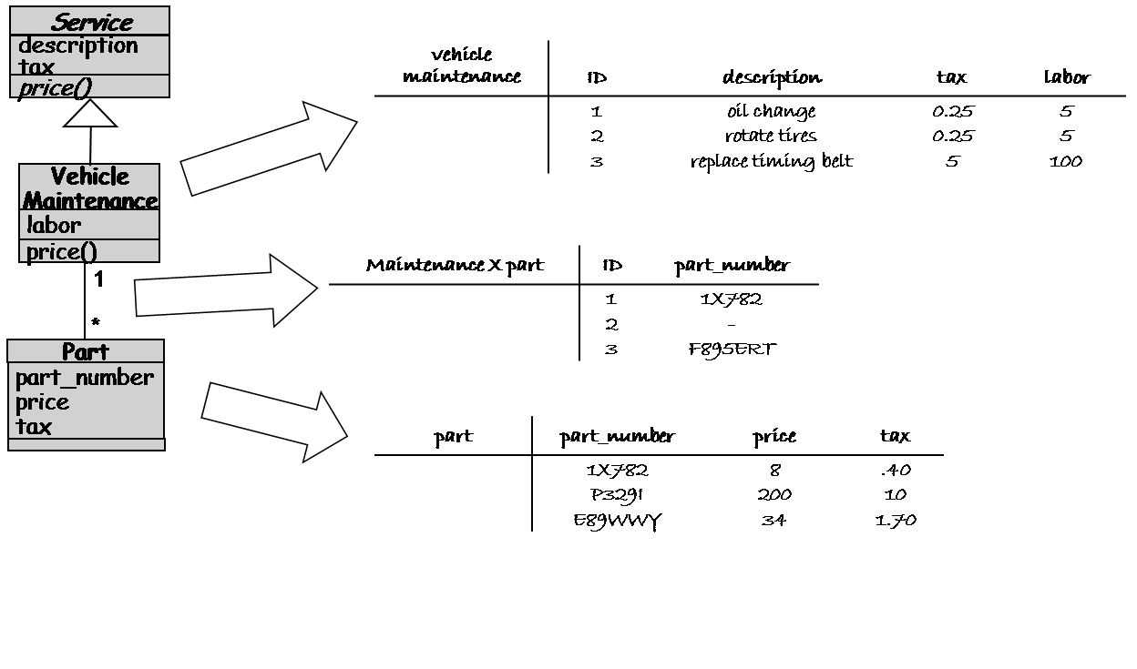
Other Design Considerations Data Management for the Royal Service Station
Physical (DB) Design (from ER)

Slide 21
Class Elaboration
Class elaboration focuses on providing a detailed description of attributes, interfaces and methods before the development of the system activities.

Slide 22
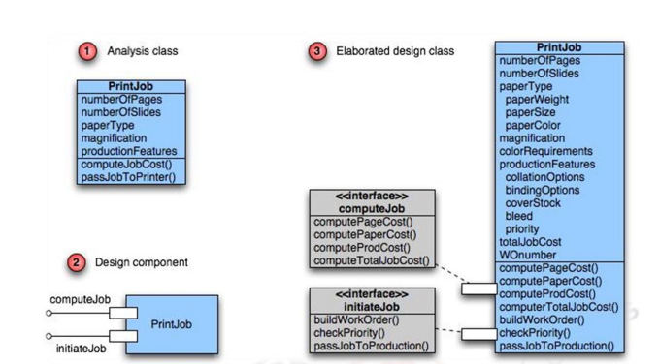
Class Elaboration

Slide 23
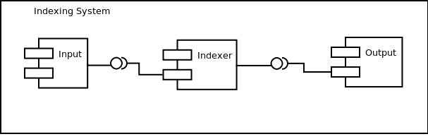
External View
Shows publicly visible behavior
Comprises of interfaces
Component may provide interfaces and also require interfaces
Components can be combined through the means of interfaces

Slide 24
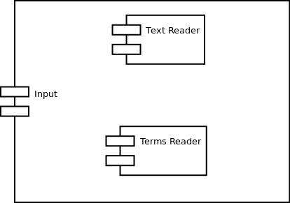
Internal View
Internals of the component
Collaborating sub-components / classes
Can be built recursively using other components
At the granular level comprises of classes

Slide 25
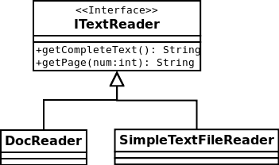
Internal View
Classes for Text Reader Component

Slide 26
Component sub-parts
Sub Components / Classes
Internals that constitute the component
Interfaces
The externally visible behavior through which components interact
Usage Dependency
Relationship between two components where one require services from the other for its full implementation
Ports
Interaction points – usually associated with interfaces
Connectors
Used to connect two or more components

Slide 27
Interface
Definition of one or collection of operations
Only provides the operations – not the implementation
Implementation is provided by a class / component
In complex systems, implementation is provided by a group of classes rather than a single class
Components may provide or require interfaces

Slide 28
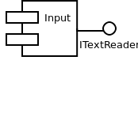

Interface
Providing an interface
Services provided by the component to its external clients
Represented by a circle
Requiring an interface
Services consumed by the component from other components for its functioning
Represented by a half-circle

Slide 29
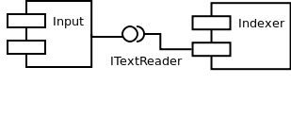
Connector - Assembly
Combines two (or more) components through a common interface
Only compatible provided and required interfaces be connected
Components may be replacable (by other components) as long as they are compatible (conforms to the same interface)

Slide 30
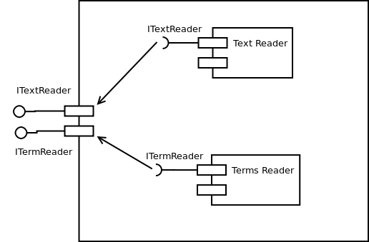
Connector - Delegation
A port may delegate to sub-ordinate components
A link between used interfaces and related ports

Slide 31
OO Component Design Principles
Open Closed Principle
“Modules shall be open for extension but closed for modification”
Dependency Inversion Principle
“Depend upon abstractions rather than concretions”
Interface Segregation Principle
“Multiple segregated interfaces are better than a single large interface”
Subtype Substitution - Subclasses should be substitutable for base classes
Notes:
Design by Contract -

Slide 32
Design Documentation Design by Contract
In design by contract, each module has an interface specification that precisely describes what the module is supposed to do
Meyer (1997) suggests that design by contract helps ensure that modules interoperate correctly
This specification, called a contract, governs how the module is to interact with other modules and system
Such specification cannot guarantee a module’s correctness, but it forms a clear and consistent basis for testing and verification
The contract covers mutual obligations (the preconditions), benefits (the postconditions), and consistency constraints (called invariants)
Together, these contract properties are called assertions

Slide 33
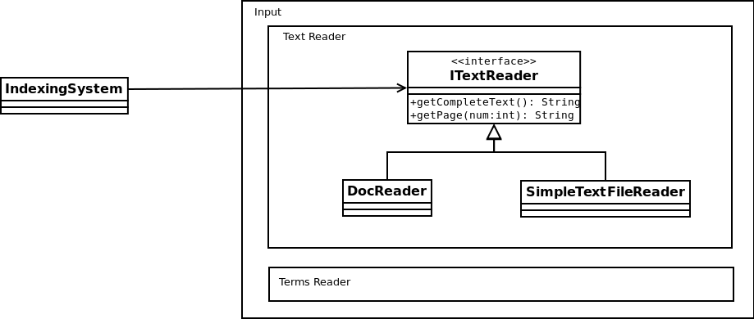
Open Closed Principle
Can extend Text Reader module without modifying its source
Notes:
There should always be room for extension without modifying the module.

Slide 34
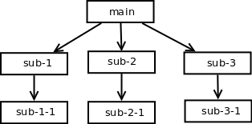
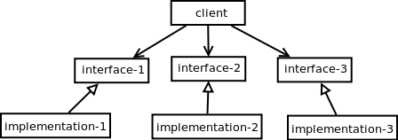
Dependency Inversion Principle
classical procedural style
object-oriented style
Depend upon abstractions rather than concretions
Notes:
Abstraction should not depend on details, as details should depend on abstraction. It’s a bad design principle to allow the high level or complex modules to majorly depend on low level classes

Slide 35
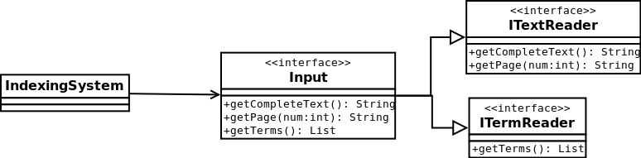
Interface Segregation Principles
Many client-specific interfaces are better than one general purpose interface
Notes:
The interfaces only that are relevant to the component under development must be depicted.

Slide 36
Packaging Principles
Release Reuse Equivalency Principle
“The granularity of reuse is granularity of release”
REP essentially means that the package must be created with reusable classes – “Either all of the classes inside the package are reusable, or none of them are”.
The classes must also be of the same family. Classes that are unrelated to the purpose of the package should not be included.
A package constructed as a family of reusable classes tends to be most useful and reusable.

Slide 37
Common Reuse Principle
“ Classes that aren't reused together, should not be grouped together”

Slide 38
Common Closure Principle
“The classes that change together, belong together

Slide 39
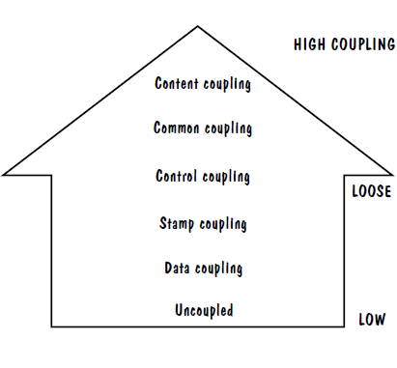
Modularity: Coupling: Types of Coupling
Content coupling
Common coupling
Control coupling
Stamp coupling
Data coupling
High coupling is NOT desired

Slide 40
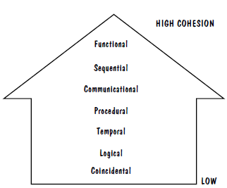
Modularity: Cohesion: Types of Cohesion
Cohesion refers to the dependence within and among a module’s internal elements (e.g., data, functions, internal modules)
Low cohesion is not desired

Slide 41
Component level design includes the following actions:
Identify Design Classes in Problem Domain
Identify Infrastructure Design Classes
Elaborate Design Classes
Describe Persistent Data Sources
Elaborate Behavioral Representations
Elaborate Deployment Diagrams
Refactor Design And Consider Alternatives

Slide 42
Component Design Steps
Steps 1 & 2 – Identify Classes
Most classes from the problem domain are analysis classes created as part of the analysis model
The infrastructure design classes are introduced as components during architectural design
Step 3 – Class Elaboration
Collaboration Details
Appropriate Interfaces
Attributes Elaboration
Describing Flow

Slide 43
Component Design Steps
Step 4 – Persistent Data
The persistent data sources are described (databases and files) and the classes required to manage them are identified
Step 5 – Elaborate Behavior
sometimes necessary to model the behavior of a design class
State diagram is used to elaborate the behavior
Step 6 – Elaborate Deployment
Deployment diagrams are elaborated to represent the location of key packages or components
Step 7 – Redesign

Slide 44
Component Design Steps
Step 4 – Persistent Data
The persistent data sources are described (databases and files) and the classes required to manage them are identified
Step 5 – Elaborate Behavior
sometimes necessary to model the behavior of a design class
State diagram is used to elaborate the behavior
Step 6 – Elaborate Deployment
Deployment diagrams are elaborated to represent the location of key packages or components
Step 7 – Redesign

Slide 45
Quiz # 4
Mention your group number
You recently completed homework with three different architectural styles.
Mention the three styles that you mentioned and discuss the best style.

